Slide 2
Sustainable sources of energy – which plant material?

Slide 3
What are fossil fuels?
Why are they important to us?
Look at the first three slides of this slide show link:
How fossil fuels are formed
What would happen if . . . . . we ran out of fossil fuels?
Notes:
Discuss with children how we use energy to do everything we do, from cooking our favourite meal to sending astronauts into space -- energy is the power to do it all. We use energy sources to generate the electricity we need for heating and cooling our homes, lighting office buildings, driving vehicles, and manufacturing the products we rely on in our daily lives. Recap from the Introduction of activity 5 that fossil fuels, such as natural gas, oil and coal, can be burned to provide us with light and heat, or to create other energy, such as electricity.
Discuss how fossil fuels are formed when prehistoric plants and animals died and were gradually buried by layers of soil. Remind children that fossil fuels will eventually run out and so are known as non-renewable forms of energy as they can not be replaced. Children should suggest that we need to find alternative, renewable forms of energy to enable us to have a more sustainable future.

Slide 4
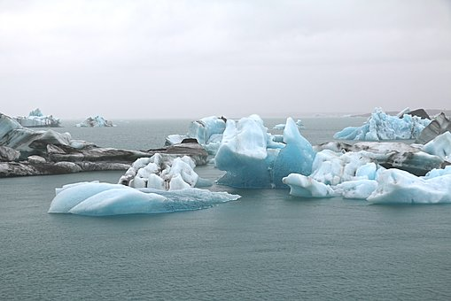
Burning fossil fuels to provide us with heating and electricity releases carbon dioxide gas into the air.
This can contribute towards climate change.
What do you think can be done to reduce the amount of carbon dioxide gas from burning fossil fuels?
Notes:
Discuss how it is important that we find new, environmentally friendly, sources of fuel for things like heating and making electricity.
Focus the discussion on how the population of the world is increasing, so to ensure that there will be enough energy for future generations, it is important to consider the ‘sustainability’ of the sources we use.

Slide 5
Renewable energy – match the names with the meanings.
energy from the sun
energy from the heat of the Earth
energy from the wind
energy from plants
energy from water
geothermal
biomass
hydropower
wind power
solar power
Notes:
Discuss how renewable energy comes from natural sources or processes that we can reproduce and use over and over again. It is important that we understand how our energy choices and decisions impact our Earth and that we consider the ‘sustainability’ of the sources of energy we use in our daily lives.
Examples shown on the slide are solar (from the sun), wind, water (hydropower), geothermal (from the heat of the earth) and biomass (from living materials such as plants).

Slide 6
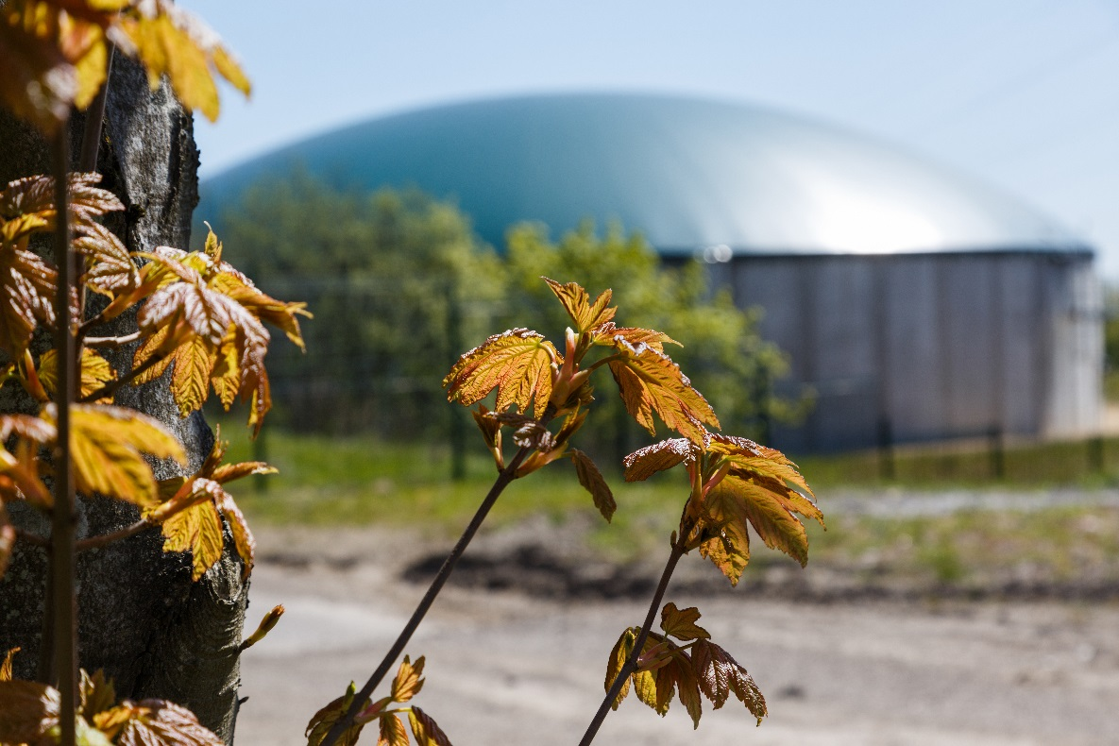
Rethinking energy sources: one company’s solution . . .
Scientists and engineers are finding clever ways to produce energy for heating and electricity from natural, sustainable sources such as plants.
A special tank uses micro-organisms (bacteria) to break down and change plants.

Slide 7
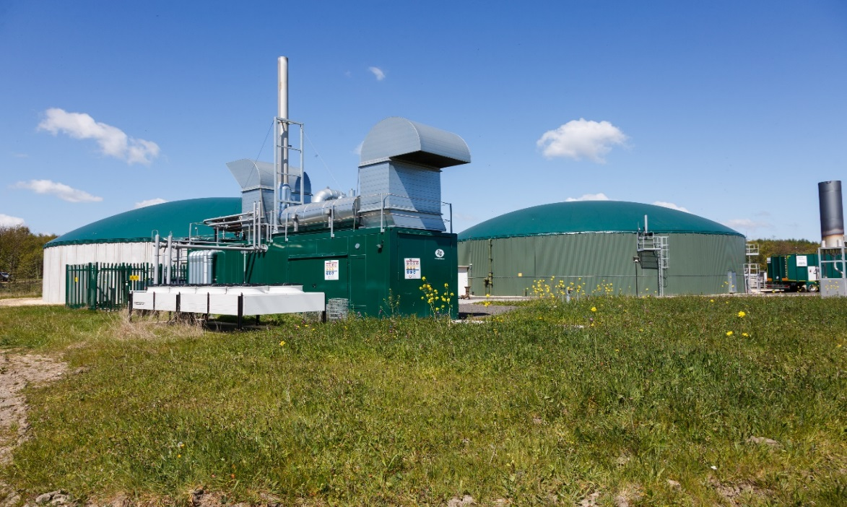
The plants are loaded into a ‘digestion’ tank and they stay there for around forty days at a temperature of 37ºC (our body temperature).
It is stirred to help release a natural gas. This gas is sent through a pipe to a storage tank. It can be burned to power a generator and produce electricity and heat.
Any plant material remaining is sent back to the farm and used to improve the soil as a fertiliser and grow healthy crops.
Notes:
It might be interesting for children to know that a temperature of 37°C is very close to that of a cow (38.5°C)! This digestion tank’s “food” is plant materials and the process of breaking the material down produce natural gas that is useful to us. There is a similarity in that cows eat or ‘digest’ plants too and are one of the largest contributors to methane gas emissions, hence, one of the reasons there is a move towards reducing meat in our diets – as linked to the previous activity looking for more sustainable sources of food.

Slide 8
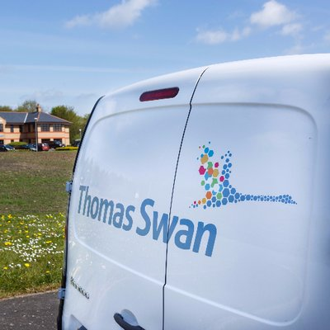
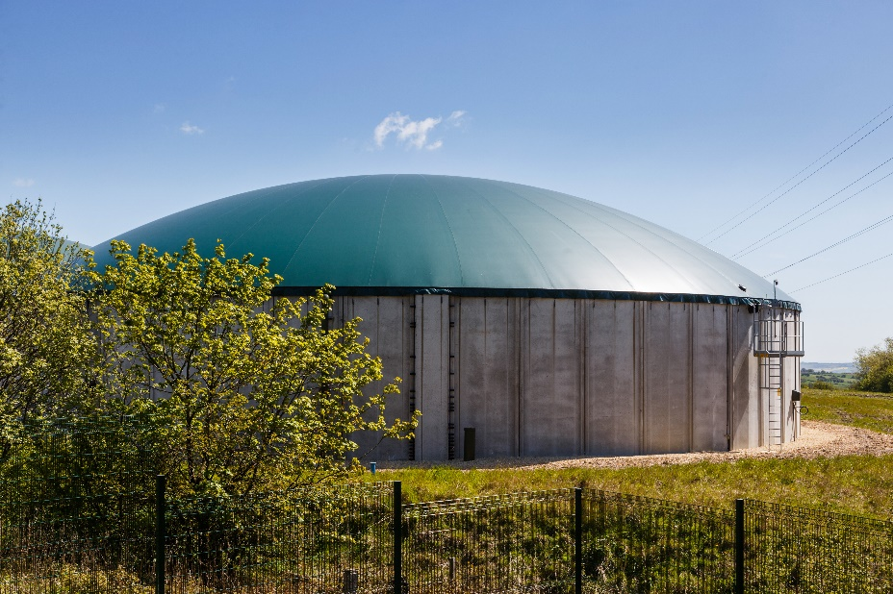
Thomas Swan in County Durham, England is an example of a company that uses plants specially grown in local farms less than ten miles away as their fuel.
They aim to achieve 100% renewable electricity on their site in the next few years.
Using plants to generate heat and electricity is cheaper for companies and better for the environment.
Notes:
At Thomas Swan, the commissioning of the special tanks – called the “Anaerobic Digestion facility” was a major step forward in their sustainability journey. It is capable of supplying 100% of their electricity requirements for manufacturing, but unfortunately during 2016 the plant had some significant technical issues that resulted in only 25% of our electricity being sourced from it. Since then, the owners of the plant are working on these issues and their aim is still to achieve 100% renewable energy supply on site.

Slide 9
www.ciec.org.uk

